Slide 1
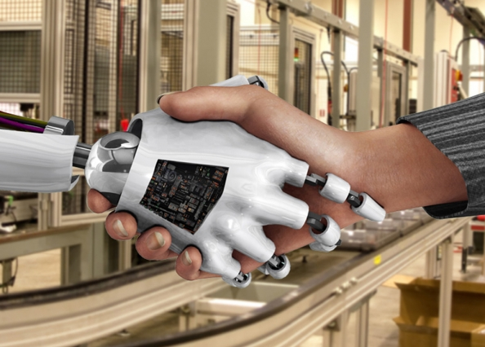
Human-Robot Interaction (HRI): Trust in Diagnostic Aiding Automation
Blake Nguyen and Na’Kiya Russell
University of Central Florida
October 30, 2018

Slide 2
Background
In HRI, the aspect of reliability is important to take into consideration when seeking research advancements in such complex teaming. Previous research regarding reliability refers to a reliability threshold. When diagnostic aiding technology falls below 70% reliability, it is seen as not useful, and will negatively affect overall task performance (Wickens & Dixon, 2007). The reliability threshold is based on tasks humans are capable of performing without needing help from such technologies.
Notes:
Insert diagram to show relevant works that list significant findings, methods, etc.
However, current human-robot teams are seeking advancements in future robotic teammates that may be capable of acting and gathering information and helping build situation awareness (SA) in environments that may be too difficult or too dangerous for human operators. Previous research has looked into reliability in relationship to the human operators’ perception of reliable and unreliable diagnostic aiding automation (robots) in various environments.

Slide 3
Previous Study Design
 | Dangerous Environment | Safe Environment
50% Reliability Rate | 50% Reliability Rate Dangerous Environment | 50% Reliability Rate Safe Environment
80% Reliability Rate | 80% Reliability Rate Dangerous Environment | 80% Reliability Rate Safe Environment

Slide 4

Previous Research Findings
Results suggested that in dangerous environmental conditions, people may perceive unreliable diagnostic aiding automation (robots) more positively and showed more willingness to work with them.

Slide 5
Purpose Statement
The purpose of this study is to explore the reliability threshold and its effect on human-robot teams in dangerous and safe environments. The study also seeks to compare at what level of expertise: novice or expert, relies more on diagnostic aiding technology (i.e., autonomous agent, automation) in such environments.

Slide 6
Research Questions
Is there a difference in perception of reliable and unreliable diagnostic aiding automation in both safe and dangerous environments when comparing levels of expertise (novice and experts)?
Do novice consider diagnostic aiding automation to be reliable or unreliable as opposed to an expert operator when automation reliability rate is set to 50% in both benign and hostile environments?

Slide 7
Hypotheses
Novice will consider diagnostic aiding automation to be unreliable when reliability is set at 50% in both safe and dangerous environments.
Experts will consider diagnostic aiding automation to be reliable only in hostile environments when reliability is set at 50%.
Experts will consider diagnostic aiding automation to be unreliable when reliability is set to 50% in safe environments.

Slide 8
Current Study Design
 | Dangerous Environment | Safe Environment
Novice | Novice Dangerous Environment | Novice Safe Environment
Expert | Expert Dangerous Environment | Expert Safe Environment

Slide 9

Study Design Information
Quasi IV: Level of Expertise (Novice vs. Expert)
IV: Environment (Dangerous vs. Safe)
DV: Participants’ level of trust on robot’s feedback
*Reliability rate is not part of the design because its kept constant at 50%.

Slide 10
Plan of Action
Determine our definition of novice and experts based on literature review.
Develop questionnaire to assess whether levels of expertise find automation reliable or unreliable.
Paper form or Qualtrics online survey engine?
Determine how to administer questionnaire to participants
Analyze data collected from Pilot Study
Complete Github readme files
Develop draft UCF IRB protocol for our research study

Slide 11
References
Image References:
http://news.mit.edu/2013/humans-robots-interaction-cross-training-0211
https://github.com/krman009/Octodex-Images-Links
https://www.google.com/search?tbm=isch&q=github+kitty&chips=q:github+kitty,g_1:octocat&usg=AI4_-kQqGakIm54gESFuomELJt-9IyMmgg&sa=X&ved=0ahUKEwilxe_x-azeAhUwh-AKHWtaBAYQ4lYIKygB&biw=1169&bih=647&dpr=2#imgrc=jwqWNATuXr5CbM:
Faerevaag, C. L., Nguyen, B. A., Jimenez, C. A., Jentsch, F. (2017). Attitudes toward unreliable diagnostic aiding in dangerous task environments. In Proceedings of the Annual Meeting of the Human Factors and Ergonomics Society (Vol. 61). Los Angeles, CA: SAGE Publications.

